Slide 1
BRITISH AIRWAYS WEB SCRAPPING USING SENTIMENT ANALYSIS TO UNCOVER INSIGHTS

Slide 2
Identify Overall Customer Sentiment
Positive Sentiment: Indicates customers are generally satisfied with the airline’s services. Positive reviews might highlight excellent customer service, on-time performance, or comfortable seating.
Negative Sentiment: Suggests dissatisfaction and could point to issues like delayed flights, lost luggage, or poor in-flight service.

Slide 3
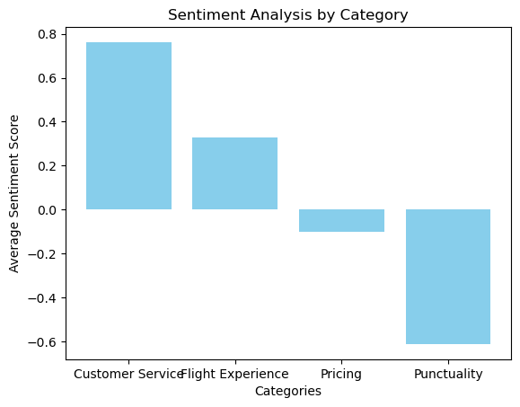
PLT.SHOW()

Slide 4
Summary of Sentiment Analysis Results
Customer Service:
Score: 0.762 (Highly Positive)
Insight: Customer service is a significant strength of the airline, with passengers appreciating the helpful and friendly nature of the staff. This can be highlighted as a competitive advantage in marketing materials and communications.
Flight Experience:
Scores: -0.2023 (Negative), 0.8625 (Very Positive)
Insight: Feedback on the flight experience is mixed. While some passengers have very positive experiences, others express dissatisfaction, particularly around aspects like seat comfort or amenities. This indicates an opportunity to improve and ensure a more consistent flight experience.

Slide 5
Pricing:
Scores: -0.2023 (Slightly Negative), 0.0 (Neutral)
Insight: Sentiment about ticket pricing is generally neutral to slightly negative. Some passengers may perceive ticket prices as high or not offering enough value. Consider reviewing pricing strategies or promoting special deals to improve perception.
Punctuality:
Score: -0.6124 (Significantly Negative)
Insight: Punctuality is a critical issue, with strong negative feedback pointing to frequent flight delays and scheduling problems. Improving on-time performance is essential to enhance overall customer satisfaction and reduce frustration.

Slide 6
Key Recommendations
1.Leverage Strength in Customer Service:
Continue to invest in training and reward programs for staff to maintain high service quality.
Use positive feedback in promotional campaigns to attract more customers.
2. Enhance Flight Experience Consistency:
Address complaints related to seating comfort and amenities.
Explore upgrading or refurbishing aircraft interiors and improving in-flight entertainment options.
3. Evaluate Pricing Strategy:
Conduct further research to understand price sensitivity among customers.
Offer value-added packages or loyalty discounts to boost satisfaction with pricing.
4. Improve Punctuality and Schedule Reliability:
Implement measures to reduce delays, such as better operational planning and increased communication.
Monitor performance metrics closely and make necessary adjustments to meet or exceed industry standards.

Slide 7
The analysis highlights areas where the airline excels and identifies critical opportunities for improvement. By addressing concerns about flight experience and punctuality, the airline can significantly improve customer sentiment and loyalty.
Prioritizing these efforts, combined with a focus on maintaining high service standards, will help strengthen the airline's reputation and customer satisfaction.

